Slide 1


Prayer Resources Week 19 Monday 26th January

Slide 2
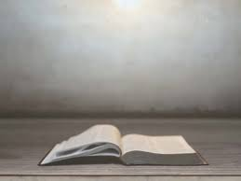
This Sunday’s Gospel Reading 3rd Sunday in Ordinary Time Year A
(Matthew 4: 12-23)
When Jesus heard that John had been arrested, he withdrew into Galilee. And leaving Nazareth he went and lived in Capernaum by the sea, in the territory of Zebulun and Naphtali, so that what was spoken by the prophet Isaiah might be fulfilled: ‘The land of Zebulun and the land of Naphtali, the way of the sea, beyond the Jordan, Galilee of the Gentiles — the people dwelling in darkness have seen a great light, and for those dwelling in the region and shadow of death, on them a light has dawned.’ From that time Jesus began to preach, saying, ‘Repent, for the kingdom of heaven is at hand.’
While walking by the Sea of Galilee, he saw two brothers, Simon (who is called Peter) and Andrew his brother, casting a net into the sea, for they were fishermen. And he said to them, ‘Follow me, and I will make you fishers of men.’ Immediately they left their nets and followed him. And going on from there he saw two other brothers, James the son of Zebedee and John his brother, in the boat with Zebedee their father, mending their nets, and he called them. Immediately they left the boat and their father and followed him.
And he went throughout all Galilee, teaching in their synagogues and proclaiming the gospel of the kingdom and healing every disease and every affliction among the people.
This is the Gospel of the Lord

Slide 3
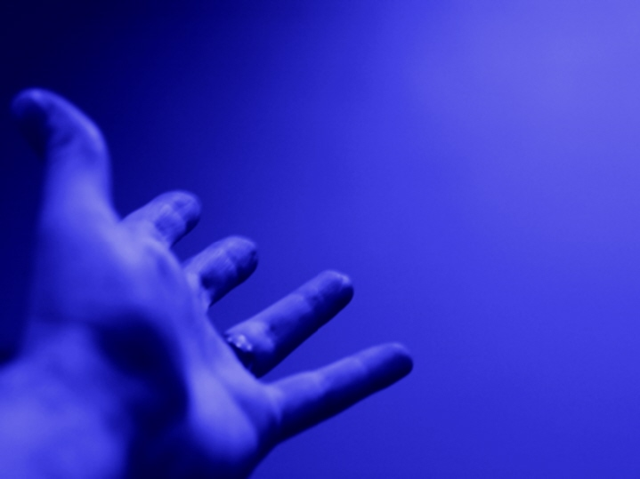
Prayer One
The Sign of the Cross
Let us remember that everything we do is
In the name of the Father, and of
the Son, and of the Holy Spirit. Amen
Reflection:
When you hear the word Kingdom, you
probably think about palaces or carriages of
thrones or something else like that

Slide 4
Jesus was a king, and he talked about his kingdom quite a lot. But this was one of the many ways in which he took the world’s expectations and turn them upside down. His kingdom was never meant to be one of riches and power and splendour, but rather one of love and peace and joy. He was a king who came to serve, and instead of a throne, he ended up put to death on a cross.
The Kingdom of God isn’t a place or a system or authority. Instead, it is the presence of things like love, justice, peace and goodness. It is the sort of world Jesus came to earth to build and the sort of world we are called to build each and every day as his followers

Slide 5
Final Prayer
LOVING FATHER...
May we never forget the things you have done for us and may we never forget the kind of world you want your followers to build. In all things give us peace, joy, love and courage.
IN THE NAME OF THE FATHER, AND OF THE SON, AND OF THE HOLY SPIRIT. AMEN.

Slide 6
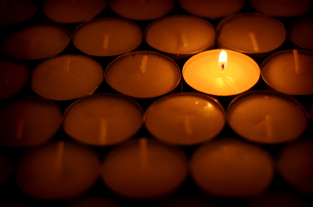
Prayer Two
The Sign of the Cross
Let us remember that everything we do is
In the name of the Father, and of
the Son, and of the Holy Spirit. Amen
Reflection
In this week's gospel, Jesus tells his listeners to repent for the Kingdom of Heaven is at hand.

Slide 7
The Kingdom of Heaven Is another phrase for the
Kingdom of God. Wherever you see either phrase in
the Bible, the word repent and is normally close by,
and there’s a really good reason for that.
Jesus was trying to make the point that in order to
have access to the amazing thing is that his kingdom
can bring, we might have to change some things in
our lives for the better.
Repentance is not about being told we are evil. It’s
about looking at our lives and asking ourselves if
there are any positive changes we can make. It’s an
invitation to take what’s good about ourselves and
make it even better!
So, this week, ask yourself if there is anything in your
life you can change for the better?

Slide 8
Final Prayer:
LOVING FATHER...
Help us to look at our lives with gratitude for the things you have given us and with honesty to change the things that aren’t quite so good. By doing this, may we come closer to you and closer to one another.
IN THE NAME OF THE FATHER, AND OF THE SON,
AND OF THE HOLY SPIRIT. AMEM

Slide 9
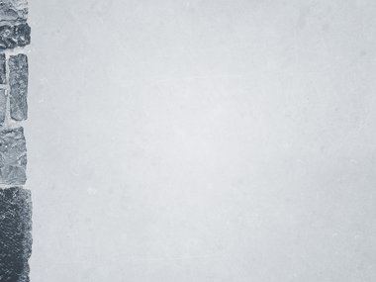
Prayer Three
The Sign of the Cross
Let us remember that everything we do is
In the name of the Father, and of
the Son, and of the Holy Spirit. Amen
Reflection: On January 27th we observe Holocaust Memorial Day.

Slide 10
This is what the Holocaust Memorial Day Trust says about the event:
“Each year on 27 January the world marks Holocaust Memorial Day (HMD). HMD has been held in the UK since 2001 and the United Nations declared this an International event in November 2005. 27 January was chosen as the date for HMD because it was on this date in 1945 that the largest Nazi killing camp Auschwitz-Birkenau was liberated.
HMD is about remembering the victims and those whose lives have been changed beyond recognition of the Holocaust, Nazi persecution and subsequent genocides in Cambodia, Rwanda, Bosnia and the ongoing atrocities today in Darfur. HMD provides us with an opportunity to honour the survivors but it’s also a chance to look to our own lives and communities today. Genocide doesn’t happen overnight, it’s a gradual process which begins when the differences between us are not celebrated but used as a reason to exclude or marginalise. By learning from the lessons of the past, we can create a safer, better future.”
What do you think about that?
What does it mean to us?

Slide 11
Final Prayer
Loving Father,
We pray for all those whose lives have been affected by holocausts and by other evil acts.
Help survivors to find peace, and help the world to learn from the mistakes of the past.
We make this prayer through Christ our Lord. Amen.

Slide 12
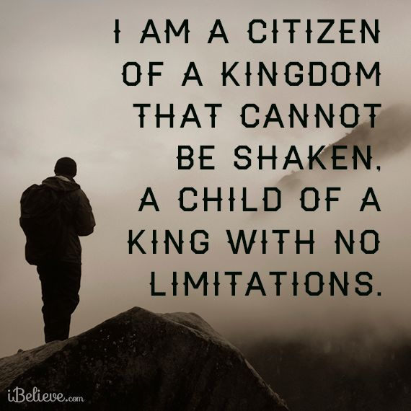
Final Thought...
Next weeks theme: Joy

