Slide 1


Prayer Resources Week 18 Monday 19th January

Slide 2

This Sunday’s Gospel – 2nd Sunday of Ordinary Time Year A
(John 1: 29-34)
At that time: John saw Jesus coming towards him, and said, ‘Behold, the Lamb of God, who takes away the sin of the world! This is he of whom I said, “After me comes a man who ranks before me, because he was before me.” I myself did not know him, but for this purpose I came baptising with water, that he might be revealed to Israel.’ And John bore witness: ‘I saw the Spirit descend from heaven like a dove, and it remained on him. I myself did not know him, but he who sent me to baptise with water said to me, “He on whom you see the Spirit descend and remain, this is he who baptises with the Holy Spirit.” And I have seen and have borne witness that this is the Son of God.’
This is the Gospel of the Lord

Slide 3

Prayer One
The Sign of the Cross
Let us remember that everything we do is
In the name of the Father, and of
the Son, and of the Holy Spirit. Amen
Reflection:
VOCATION, our theme for this week, is a really beautiful word. When we hear the word, we probably think about priests or nuns. That’s obviously a really important part of Church life, but the word Vocation is much wider than that…

Slide 4
Vocation, put simply, is a word that is just there to remind us that we all have a purpose. We were all created by a loving God who had an amazing plan for us.
How do you feel to hear that you have a vocation? How does it feel to know that there is a plan for you? Does it make you feel better about yourself? Does it say anything to you about those times when you feel a little bit weak or useless?
As you grow and move through life God's plan for you,
your vocation, will slowly unfold. You will have a lot of fun as you figure out more and more about what it is

Slide 5
Final Prayer
LOVING FATHER...
You created us in love and you put so much care into forming a plan for each of our hearts. Help us to have
hearts full of love and amazement as your plan slowly unfolds in front of us, and in all things give us love, hope,
faith, joy and courage.
IN THE NAME OF THE FATHER, AND OF THE SON, AND OF THE HOLY SPIRIT. AMEN.

Slide 6
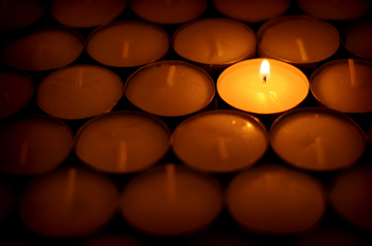
Prayer Two
The Sign of the Cross
Let us remember that everything we do is
In the name of the Father, and of
the Son, and of the Holy Spirit. Amen
Reflection
The word vocation is broader than just priests
and religious orders, but nevertheless this is
really important. In fact, it's probably the thing
we think about first when we hear the word.

Slide 7
People who have taken vows of one kind or
another, whether priests or religious brothers,
or nuns, have decided to dedicate their lives to
the service of the Church in a special way.
As Catholics, we try our best to support these
people with our love and with our prayers.
So, this week let us take the time to pray for
everybody in Holy Orders. Let’s ask God to look after them, to give them strength, and to bring them success in all that they do.

Slide 8
Final Prayer:
LOVING FATHER...
Your Son asked for labourers to be sent to the vineyard, and in every generation so many men and women have responded generously to this call.
We pray for our clergy, for our Bishop, and for everybody else who serves your Church in this way. Watch over them and keep them always in your love
IN THE NAME OF THE FATHER, AND OF THE SON, AND OF THE HOLY SPIRIT. AMEN.

Slide 9
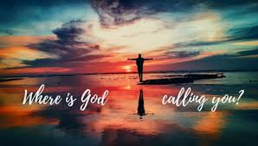
Prayer Three
The Sign of the Cross
Let us remember that everything we do is
In the name of the Father, and of
the Son, and of the Holy Spirit. Amen
Reflection
Every four years on January 20th, the American people swear in a president. This will happen again in 2029

Slide 10
Events like coronations or inaugurations, when leaders begin to lead, often draw a lot of attention.
Not any of us will end up being Presidents, Prime Ministers or heads of big organisations. But we are all in a position where we can make a difference.
We have all been chosen for one job or another, and that job will make a difference. And God has given us exactly what we need to do that job.
It may be to raise a family or to do a certain type of job; or it may be to do something for the community around us.
Either way, we are all chosen. Each and every one of us.
Find out more about what “Vocation” feels like:
vocation christian - Google Search (6 mins long)

Slide 11
Final Prayer
God our Father, help us to remember that when you were dividing up the important jobs, you didn’t leave anybody out.
Help us to remember that we were all chosen to make a difference and to rely on the fact that you are with us all the way.
Our Father, who art in heaven…
In the name of the Father and of the Son…

Slide 12
Final Thought...
Next weeks theme: Kingdom of God

