Slide 1


Prayer Resources Week 17 Monday 12th January

Slide 2

Feast of the Baptism of the Lord, Year
(Matthew 3: 13-17)
At that time: Jesus came from Galilee to the Jordan to John, to be baptised by him. John would have prevented him, saying, ‘I need to be baptised by you, and do you come to me?’ But Jesus answered him, ‘Let it be so now, for thus it is fitting for us to fulfil all righteousness.’ Then he consented. And when Jesus was baptised, immediately he went up from the water, and behold, the heavens were opened to him, and he saw the Spirit of God descending like a dove and coming to rest on him; and behold, a voice from heaven said, ‘This is my beloved Son, with whom I am well pleased.’
This is the Gospel of the Lord

Slide 3
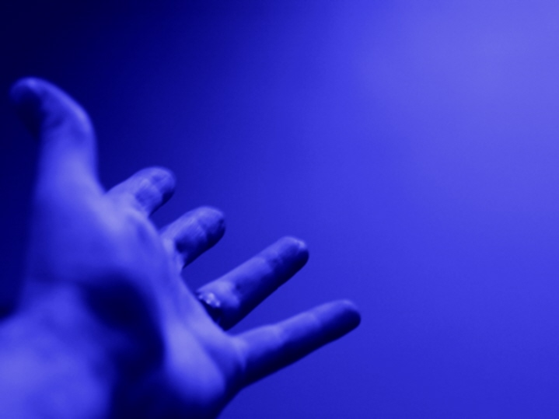
Prayer One
The Sign of the Cross
Let us remember that everything we do is
In the name of the Father, and of
the Son, and of the Holy Spirit. Amen
Reflection:
For Christians, baptism is a sort of gateway. It welcomes us into the Christian community and it opens to us the rest of the sacraments and the joys of Christian life.
.

Slide 4
The start of something is always an exciting time. Especially when it's something that we know will bring us a lot of joy and happiness.
Baptism is a free gift. It is God’s way of letting us know that we are one of his children and that, if we want to, we can receive any of the things that he has promised to us.
If you stop and think about it, it’s really quite an amazing thing.
Perhaps today we can take a moment to stop and to pray for all those who have been baptised recently, and for all those who are about to be.
Let’s pray that they all come to realise the beauty of what they are receiving.

Slide 5
Final Prayer
Loving Father,
We thank you for the gift of baptism and we pray for all those who are receiving this gift around this time. May they be filled with your love and may their baptism be the beginning of a bright and happy life with you.
In the name of the Father and of the Son…

Slide 6
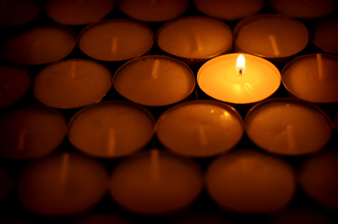
Prayer Two
The Sign of the Cross
Let us remember that everything we do is
In the name of the Father, and of
the Son, and of the Holy Spirit. Amen
Reflection
In this week’s reading we hear the voice of God calling down from Heaven. As Jesus was baptised the voice said, ‘This is my beloved Son, with whom I am well pleased.’

Slide 7
It’s always nice to know that people are pleased with us and proud of us. That’s why parents and teachers often go out of their way to tell us when we have done something good.
The fact that God spoke to his people at the moment when Jesus was baptised says a lot. He wanted us to know that Baptism was something important to him, but perhaps he also wanted us to know that when we are proud of somebody, and when they bring us happiness, it is important to share that fact with them and to let them know.
Think about all the people in your life who you love? How many people are there around you who bring you joy and make you feel better for having known them?
Friends? Parents? Family members?
When was the last time that you told these people how much they meant to you?

Slide 8
Final Prayer:
Loving Father,
When your Son was sealed with the gift of your baptism you showed the world how much you loved him. Help us to have that same wisdom and gratitude. May we be always be willing to show those close to us how much we love them and how much they mean to us.
In the name of the Father and of the Son…

Slide 9

Prayer Three
The Sign of the Cross
Let us remember that everything we do is
In the name of the Father, and of
the Son, and of the Holy Spirit. Amen
Reflection
During this week when we think about baptism, we should remember one of the most important things that baptism does...

Slide 10
As well as marking us out as part of the Church and as part of God’s family, Baptism also forgives our sins.
In other words, when people come to faith and accept Baptism, God tells them that the things they might have done wrong in the past are forgiven. This means that they have a clean slate and can almost start again.
Being sorry for things we have done wrong and being told that we are forgiven is an important part of Christian life.
Our faith reminds us that whenever we do something wrong we can always turn to God if we are genuinely sorry and we will be forgiven.
This is something that should always be celebrated and remembered.
For further reflection on this weeks theme click here:
%I — THE REDEEMED (10 minute prayerful film)

Slide 11
Final Prayer
Loving Father,
We thank you for your loving kindness and for the fact that you don’t hold our sins against us.
Help us to have the grace and the humility to recognise when we do something wrong and to ask for forgiveness from you and from those we hurt.
In the name of the Father and of the Son…

Slide 12
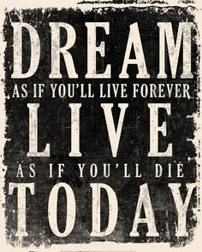
Final Thought...
Next weeks theme: Vocation

