Slide 1
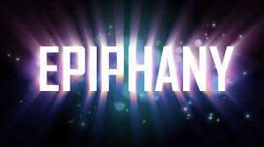

Prayer Resources Week 16 Monday 5th January

Slide 2
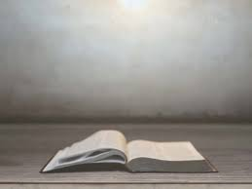
Gospel from the Feast of The Epiphany of the Lord
(Matthew 2: 1-12)
Now after Jesus was born in Bethlehem of Judea in the days of Herod the king, behold, wise men from the east came to Jerusalem, saying, ‘Where is he who has been born king of the Jews? For we saw his star when it rose and have come to worship him.’ When Herod the king heard this, he was troubled, and all Jerusalem with him; and assembling all the chief priests and scribes of the people, he enquired of them where the Christ was to be born. They told him, ‘In Bethlehem of Judea, for so it is written by the prophet:
“And you, O Bethlehem, in the land of Judah,
are by no means least among the rulers of Judah;
for from you shall come a ruler
who will shepherd my people Israel.” ’
Then Herod summoned the wise men secretly and ascertained from them what time the star had appeared. And he sent them to Bethlehem, saying, ‘Go and search diligently for the child, and when you have found him, bring me word, that I too may come and worship him.’ After listening to the king, they went on their way. And behold, the star that they had seen when it rose went before them until it came to rest over the place where the child was. When they saw the star, they rejoiced exceedingly with great joy. And going into the house, they saw the child with Mary his mother, and they fell down and worshipped him. Then, opening their treasures, they offered him gifts, gold and frankincense and myrrh. And being warned in a dream not to return to Herod, they departed to their own country by another way.
This is the Gospel of the Lord

Slide 3
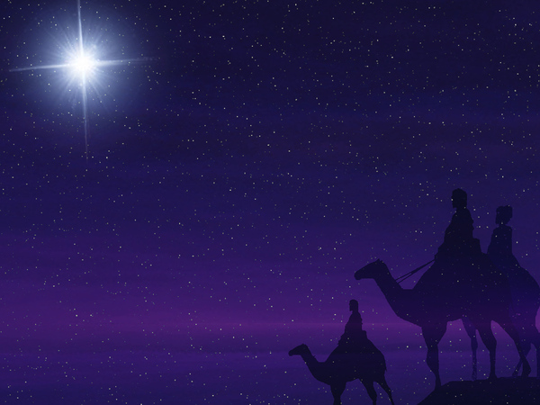
Prayer One
The Sign of the Cross
Let us remember that everything we do is
In the name of the Father, and of
the Son, and of the Holy Spirit. Amen
Reflection:
The feast of the Epiphany is celebrated on 6th January every year. It recalls the visit of the Magi to the baby Jesus, and it reminds us of the importance that was attached to the birth of the Son of God.

Slide 4
The word ‘epiphany’ is quite hard to explain in some ways. When somebody has an epiphany it means that they are surprised by suddenly realising something that they didn’t realise before. Something strikes them suddenly and they are opened up to things that they weren’t aware of before.
The birth of Jesus was an epiphany to many people for lots of different reasons. At that time in history things must have felt pretty hopeless for a lot of people. Their land had been conquered and they couldn’t see a way out, and they saw their God as being far away and distant. But the coming of Christ changed all that. It gave people hope and it showed them that God loved them and cared for them.
The Magi followed the star to where the baby Jesus was. When they found him, they were grateful and they allowed themselves to be changed by the experience. The season of Christmas and the Feast of the Epiphany invite us all to do exactly the same: to be grateful, and to let the experience change us for the better.

Slide 5
Final Prayer
Loving Father,
You loved us so much that you came into our world, and you stuck around long enough to teach us, to live with us, and to die for us. In this week where we remember the visit of the Magi to the new-born king, we ask for the same courage and gratitude that they showed.
In the name of the Father and of the Son…

Slide 6
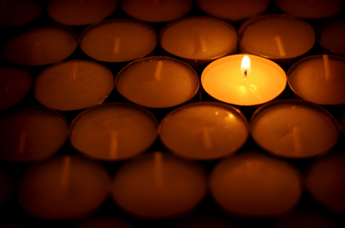
Prayer One
The Sign of the Cross
Let us remember that everything we do is
In the name of the Father, and of
the Son, and of the Holy Spirit. Amen
Reflection: Happy New Year…Have you made any resolutions? Have you broken any yet??!

Slide 7
So, it’s a new year…
2025 is gone, and it will never be back.
2026 is with us, and we’ll only get one
chance to get it right.
As we start 2026, think about
what you want to do this year…
What do you want to achieve?...
How do you want to make yourself better?...
As you do, ask God to be with you…

Slide 8
Final Prayer:
LOVING FATHER...
Look after us this year, and help us to do your will.
Keep us happy, safe and close to you.
IN THE NAME OF THE FATHER, AND
OF THE SON, AND OF THE HOLY SPIRIT.
AMEN

Slide 9
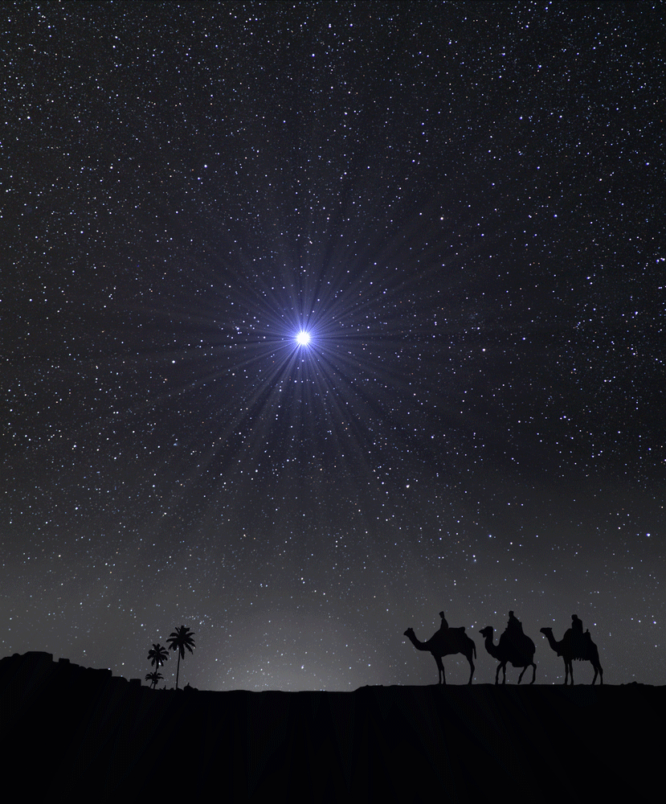
Prayer Three
The Sign of the Cross
Let us remember that everything we do is
In the name of the Father, and of
the Son, and of the Holy Spirit. Amen
Reflection
When we think about the baby Jesus in the manger we remember the bright star that was shining in the East. It showed where the baby Jesus was lying.

Slide 10
The bright star above the manger which the Magi followed is a really lovely image. It showed them where the baby Jesus was. In other words, it pointed the way to something amazing.
As Christians, we are called to do exactly what the star did: we are called to point to something amazing; something more than just ourselves.
But how can we do this? It sounds a little complicated!
One of the reasons why Jesus came to earth was to show us how to live in harmony and peace with one another, and to show us what it meant to love and to serve.
If we can get these things right then we will point the way to God and we will show people something really amazing.

Slide 11
Final Prayer
Loving Father,
You put the star in the sky to show the Magi the way, and you put Jesus into our world to show us the way. Help us to live lives that always point others toward something amazing. Help us to be people who shine brightly in the darkness.
In the name of the Father and of the Son…

Slide 12
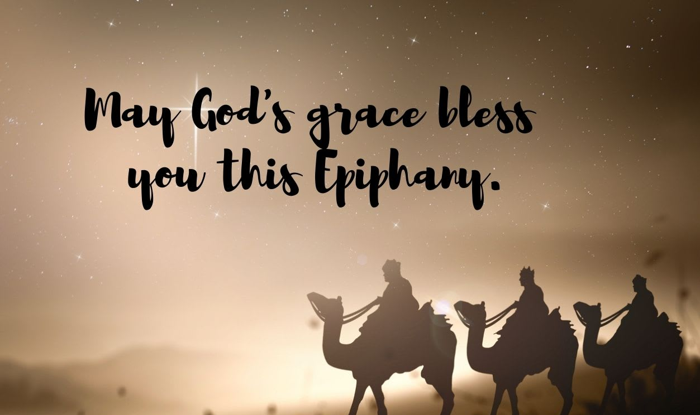
Final Thought...
Next weeks theme : Baptism

