Slide 1


Prayer Resources Week 15 Monday 15th December

Slide 2

r

Slide 3

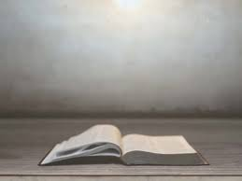
Sundays Gospel: Matthew 11:2-11
At that time: When John heard in prison about the deeds of the Christ, he sent word by his disciples and said to him, ‘Are you the one who is to come, or shall we look for another?’
And Jesus answered them, ‘Go and tell John what you hear and see: the blind receive their sight and the lame walk, lepers are cleansed and the deaf hear, and the dead are raised up, and the poor have good news preached to them. And blessed is the one who is not offended by me.’
As they went away, Jesus began to speak to the crowds concerning John: ‘What did you go out into the wilderness to see? A reed shaken by the wind? What then did you go out to see? A man dressed in soft clothing? Behold, those who wear soft clothing are in kings’ houses.
‘What then did you go out to see? A prophet? Yes, I tell you, and more than a prophet. This is he of whom it is written,
“Behold, I send my messenger before your face,
who will prepare your way before you.”
‘Truly, I say to you, among those born of women there has arisen no one greater than John the Baptist. Yet the one who is least in the kingdom of heaven is greater than he.’
This is the Gospel of the Lord
Notes:
Matthew 11: 2-11
Now when John heard in prison
about the deeds of the Christ,
he sent word by his disciples
and said to him, "Are you he
who is to come, or shall we
look for another?" And Jesus
answered them, "Go and tell
John what you hear and see:
the blind receive their sight
and the lame walk, lepers are
cleansed and the deaf hear,
and the dead are raised up,
and the poor have good news
preached to them. And blessed
is he who takes no offense at me."
As they went away, Jesus began to
speak to the crowds concerning John:
"What did you go out into the
wilderness to behold? A reed shaken
by the wind? Why then did you go
out? To see a man clothed in soft
raiment? Behold, those who wear soft
raiment are in kings' houses. Why
then did you go out? To see a
prophet? Yes, I tell you,
and more than a prophet.
This is he
of whom it is
wr i t t e n ,
`Behold,
I send my messenger before thy face,
who shall prepare thy way before
thee.' Truly, I say to you, among those
born of women there has risen no
one greater than John the Baptist; yet
he who is least in the kingdom of
heaven is greater than he.
The Gospel of the Lord

Slide 4
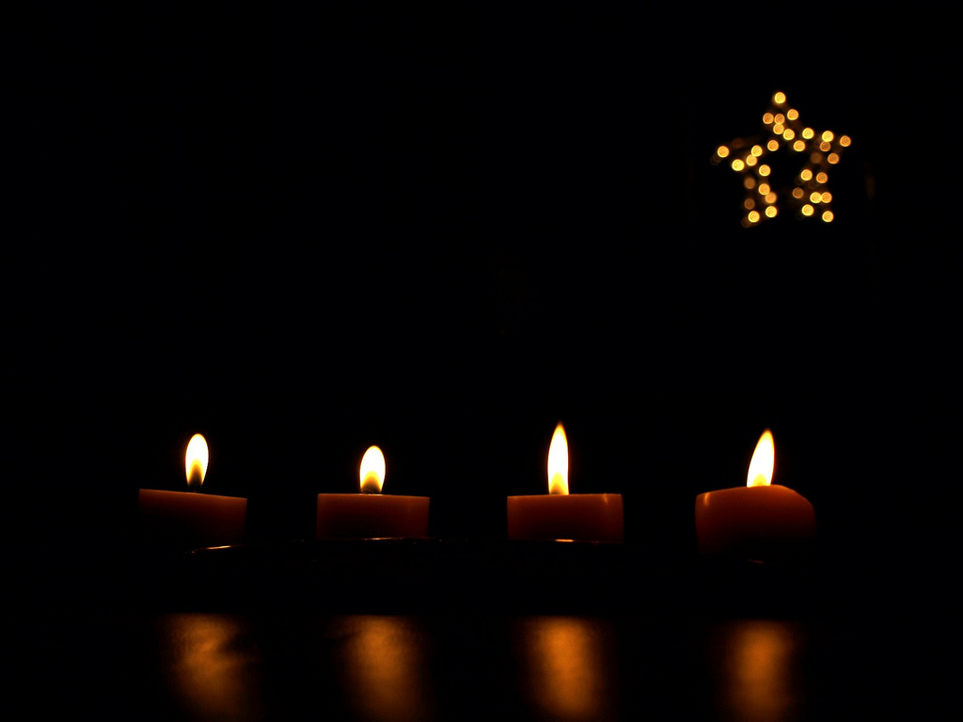
Prayer One
The Sign of the Cross
Let us remember that everything we do is
In the name of the Father, and of
the Son, and of the Holy Spirit. Amen
Reflection: The incarnation is at the very heart of our faith. In fact, the Church says that it's one of the most important beliefs that we hold as Christians.

Slide 5
At the heart of our faith, is a belief that our God wanted to be
with his people. He didn't just create us and then leave us to it,
rather in wanting to walk with us and to show us is love up close.
When you think about it, the incarnation is a remarkable example of humility.
God created the universe, after all. He has everything. In every possible way, he is absolutely perfect. But yet he chose to be with his people, to teach them, to heal them, them love them, them serve them, And ultimately to die for them.
This is what we celebrate at Christmas
Its not just about cake and presents, and about what's on TV.
It's about an amazing God who wanted to be with his people.

Slide 6
Final Prayer
As we celebrate Christmas, help us the feel the same joy that everybody else feels. Help us to relax, to enjoy giving and receiving gifts, to enjoy the love of those we are close to, and everything else the world gives us during this time.
But help us too, to realise that there is more to this season. Help us to realise that it only happened because of a God who wanted to be with his people.
IN THE NAME OF THE FATHER, AND OF THE SON, AND OF THE HOLY SPIRIT. AMEN.

Slide 7
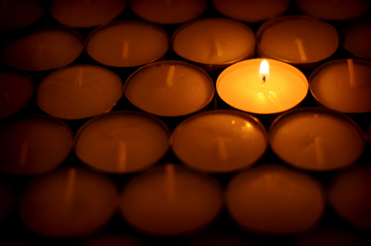
Prayer Two
The Sign of the Cross
Let us remember that everything we do is
In the name of the Father, and of
the Son, and of the Holy Spirit. Amen
Reflection: There is an old saying about Christianity: Christianity is not a spectator sport!

Slide 8
The point is that Christians are supposed to be active.
We are supposed to be people who get involved.
People who love, people who serve, people who make a
positive difference in the world and don't simply sit on the
side-lines.
This is the example we are set by the incarnation. It is an example which reminds us that there is a beautiful world that God created and that it is better for us and better for the world when we engage with it.
This is one of the most beautiful messages of Christmas. So, as you celebrate this Christmas ask yourself what you can do to get more
involved next year.
What can you do to get more involved with your family?
What can you do to get more involved in your local community?
What difference can you really make?

Slide 9
Final Prayer:
LOVING FATHER...
You never created us to sit on the side-lines and observe. You made us to get involved, to make a difference, and to grow as we do.
This Christmas, help us to consider how we can get more involved.
IN THE NAME OF THE FATHER, AND OF THE SON, AND OF THE HOLY SPIRIT. AMEN.

Slide 10
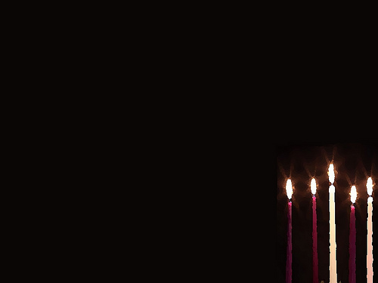
Prayer Three
The Sign of the Cross
Let us remember that everything we do is
In the name of the Father, and of
the Son, and of the Holy Spirit. Amen
Reflection: This is the last week in school before we stop for the Christmas holidays.

Slide 11
Let us take a moment today to have a short prayer to ask God to watch over the world this Christmas.
Let us pray this morning for those who are in need this Christmas. For those who are suffering this Christmas. For those who are feeling unloved and alone this Christmas. Let us pray that they all feel the joy that comes from this amazing season.
And let us pray too, for everybody in our community, that we have a happy, safe Christmas and that we return to school refreshed and ready for 2026!!!

Slide 12
Final Prayer
LOVING FATHER...
Help all of your children, wherever they may be, have a happy, holy and joyful Christmas.
IN THE NAME OF THE FATHER, AND OF
THE SON, AND OF THE HOLY SPIRIT.
AMEN.

Slide 13
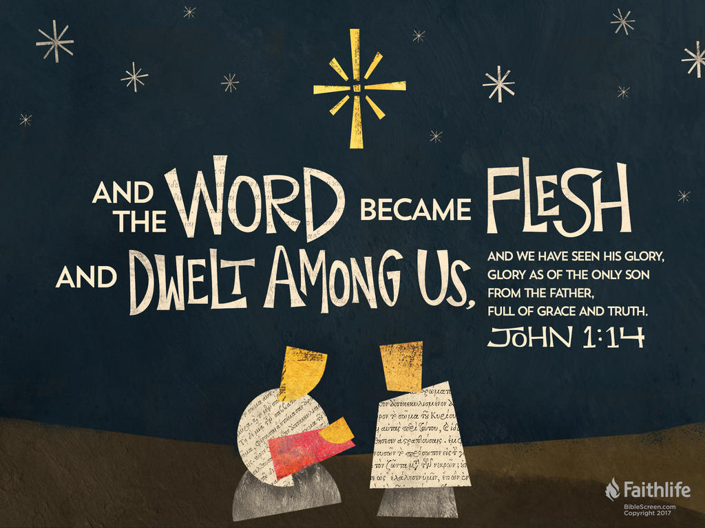
Final Thought...
After the break: Epiphany

