Slide 1


Prayer Resources Week 5 Monday 26th Sept

Slide 2
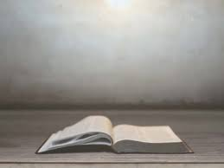
Sundays Gospel
Luke 16:19-31
At that time: Jesus said to the Pharisees, ‘There was a rich man who was clothed in purple and fine linen and who feasted sumptuously every day. And at his gate was laid a poor man named Lazarus, covered with sores, who desired to be fed with what fell from the rich man’s table. Moreover, even the dogs came and licked his sores. The poor man died and was carried by the angels to Abraham’s side. The rich man also died and was buried, and in Hades, being in torment, he lifted up his eyes and saw Abraham far off and Lazarus at his side. And he called out, “Father Abraham, have mercy on me, and send Lazarus to dip the end of his finger in water and cool my tongue, for I am in anguish in this flame.” But Abraham said, “Child, remember that you in your lifetime received your good things, and Lazarus in like manner bad things; but now he is comforted here, and you are in anguish. And besides all this, between us and you a great chasm has been fixed, in order that those who would pass from here to you may not do so, and none may cross from there to us.” And he said, “Then I beg you, father, to send him to my father’s house — for I have five brothers — so that he may warn them, lest they also come into this place of torment.” But Abraham said, “They have Moses and the Prophets; let them hear them.” And he said, “No, father Abraham, but if someone goes to them from the dead, they will repent.” He said to him, “If they do not hear Moses and the Prophets, neither will they be convinced if someone should rise from the dead.” ’
This is the Gospel of the Lord

Slide 3
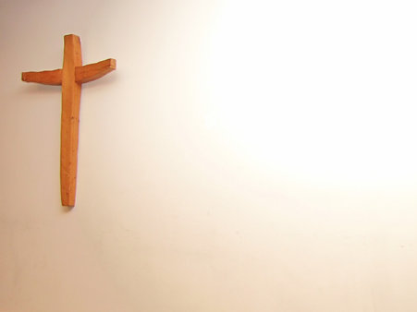
Prayer One
The Sign of the Cross
Let us remember that everything we do is
In the name of the Father, and of
the Son, and of the Holy Spirit. Amen
Reflection: One interesting thing that comes out of this week’s Gospel reading is the idea of motives.

Slide 4
The Rich man in the Gospel story gets punished for failing to feed the poor man, Lazarus, and wants to warn his family of the punishment that awaits them for failing to be kind to the poor.
His request is refused, largely because of a judgment that it probably won’t do any good. Perhaps the point here is that God doesn’t want us doing good things because there is a gun being held to our heads. In other words, we shouldn’t be good to avoid punishment. We should be good simply because we are good and because doing good is the right thing to do.
In this story, as with many others in the Gospels, the important
thing is the heart and the motives behind our intentions.
Think about that as you go through today and this week:
What are your motives?
What are the reasons why you do the thing that you do?

Slide 5
Final Prayer
LOVING FATHER...
May our hearts always be pure and our motives full of love and compassion. May we never need to be encouraged to do what’s right, but may it always be the first thought on our minds.
IN THE NAME OF THE FATHER, AND OF THE SON, AND OF THE HOLY SPIRIT. AMEN.

Slide 6
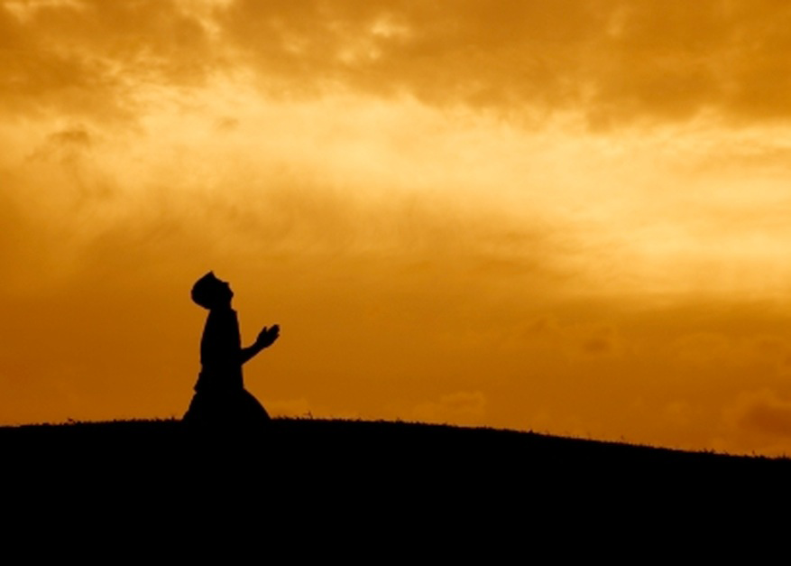
Prayer Two
The Sign of the Cross
Let us remember that everything we do is
In the name of the Father, and of
the Son, and of the Holy Spirit. Amen
Reflection:
Pope Francis was clear that as Christians we have a duty to be charitable. He took his name and inspiration from St Francis of Assisi who's feast day is celebrated on 4th October

Slide 7
A few days after becoming Pope, Pope Francis recalled the moment when he, and the other Cardinals, realised that he would be elected Pope. The counting of votes passed a certain point and as it became clear that Cardinal Bergoglio had taken it the Cardinals started to applaud. A friend of Bergoglio’s sitting next to him took his arm and said to him ‘don’t forget the poor!’
These words had a profound affect on Pope Francis and as the counting continued he decided to chose the name Francis. Francis of Assisi was a great champion of the poor and by choosing that name the new Pope hoped that he would make his priorities clear. A few days later during one of his first interviews, Pope Francis said that he wanted to see ‘A church that is poor... and for the poor!’ He was always very clear about serving the poor. He taught that it’s the main priority for the Church and it’s something he wanted individual Christians to devote themselves to as well.
When Pope Francis died many story's of how he was the Pope of the Poor and vulnerable came out. Click below for an example: The nun that wept inconsolably upon seeing Pope Francis' casket

Slide 8
Final Prayer
We thank you for the life of Pope Francis.
We ask you to keep his message alive now that he is no longer on earth with us. Work through our hearts and minds so that always and everywhere we may treat those less fortunate than ourselves with kindness, love
and generosity.
Saint Francis of Assisi
Pray for us
IN THE NAME OF THE FATHER, AND OF THE SON, AND OF THE HOLY SPIRIT. AMEN.

Slide 9

Prayer Three
The Sign of the Cross
Let us remember that everything we do is
in the name of the Father, and of
the Son, and of the Holy Spirit. Amen
Reflection:
We hear the word charity all of the time, but what does it really mean?

Slide 10
We hear the word charity all of the time. Some of the time it’s used to describe organisations that organise efforts to help the disadvantaged, and other times perhaps, it’s used to describe our own generosity and selflessness.
Originally though, the word charity simply meant love, or Christian love, as some suggest. It’s an interesting root. It reminds us that the heart of all good deeds; the heart of all giving is love. Love of God, love of creation, love of our neighbour.
This week, have a think about what you really love

Slide 11
Final Prayer
LOVING FATHER...
We can only love others because you first loved us, and that love stays at the heart of every good action your children perform.
Help us always to be filled with your love and help that love to cast out any darkness and worries in our lives.
IN THE NAME OF THE FATHER, AND OF THE SON, AND OF THE HOLY SPIRIT. AMEN.

Slide 12

Final Thought...
Next weeks theme: Faith

