Slide 1


Prayer Resources Week 3 Monday 15th Sept

Slide 2
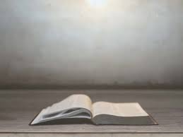
The Feast of The Exaltation of the Holy Cross
Gospel: John 3:13-17
At that time: Jesus said to Nicodemus, ‘No one has ascended into heaven except he who descended from heaven, the Son of Man. And as Moses lifted up the serpent in the wilderness, so must the Son of Man be lifted up, that whoever believes in him may have eternal life. For God so loved the world, that he gave his only begotten Son, that whoever believes in him should not perish but have eternal life. For God did not send his Son into the world to condemn the world, but in order that the world might be saved through him.’
This is the Gospel of the Lord

Slide 3
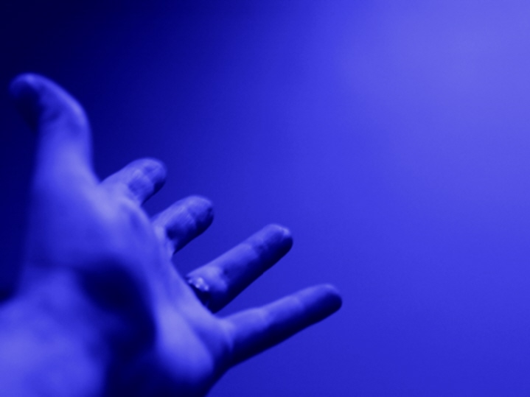
Prayer One
The Sign of the Cross
Let us remember that everything we do is
In the name of the Father, and of
the Son, and of the Holy Spirit. Amen
Reflection:
This week we celebrate the feast of The Exaltation of the Holy Cross (14th Sept)

Slide 4
When we celebrate the Exaltation of the Holy Cross, in fact anytime that we think about the cross, we remember the greatest act of love and sacrifice that the world has ever known.
The Carthusian Monks have as their motto Stat crux dum volvitur orbis. In English: The cross stays still while the world is turning. The point being that in a hectic, confusing world, it’s the one thing that stays true and reliable. The great act of love is a great hope and sources of strength for us all.
This hope and strength stem from the fact that our God chose to act. He chose to become a man. Ultimately, he chose the cross. Through his death on the cross, Jesus gave us a way to know the love of God, the forgiveness of our sins and eternal life with him.
The cross reminds us that we are loved by God, but it also reminds us that acting has powerful consequences, and that by getting involved and helping out we can make a real difference. Certainly, none of us are Jesus. But we are called to be giving and loving, just as he was.

Slide 5
Final Prayer
Loving Father,
At this time we are reminded of the amazing things you have done for your people.
Give us that same spirit of love and generosity. Help us to be generous in acting for others, and courageous in facing the things we have to do. In all things, give us wise minds and loving hearts.
In the name of the Father and of the Son…

Slide 6
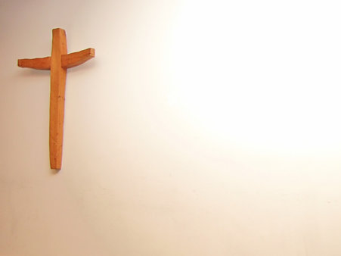
Prayer Two
The Sign of the Cross
Let us remember that everything we do is
In the name of the Father, and of
the Son, and of the Holy Spirit. Amen
Reflection: This week’s Gospel gives us the line “For God so loved the world, that he gave his only begotten Son, that whoever believes in him should not perish but have eternal life.”

Slide 7
Take some time to reflect on this quote:
“For God so loved the world, that he gave his only begotten Son, that whoever believes in him should not perish but have eternal life.”
What does it mean to be “loved”?
How do you feel “loved”?
How do you make others feel “loved”?
What else does this quote mean to you?
How is this quote seen as a message of Hope?

Slide 8
Final Prayer
LOVING FATHER...
You created people out of nothing but love and you continue to show us great love. Help us to appreciate all the great things that are done for us, by you and by those around us, and help us to show love ourselves.
IN THE NAME OF THE FATHER, AND OF THE SON, AND OF THE HOLY SPIRIT. AMEN.

Slide 9
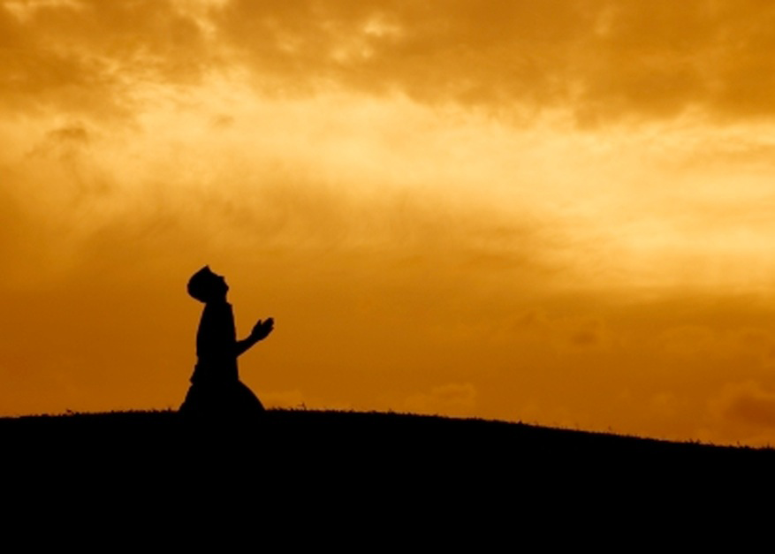
Prayer Three
The Sign of the Cross
Let us remember that everything we do is
In the name of the Father, and of
the Son, and of the Holy Spirit. Amen
Reflection:
What does “love” look like?

Slide 10

Reflect on this image…what does it mean?
Watch the following clip to explore the answer to “What does love look like?”
%I — THE REDEEMED

Slide 11
Final Prayer
LOVING FATHER...
You create people not to be alone but to live in love and harmony with one another. We thank you for all those
who love us and support us.
We ask you today to watch over our friends & families everywhere and to help us to appreciate our friends & families more and more.
IN THE NAME OF THE FATHER, AND OF THE SON, AND OF THE HOLY SPIRIT. AMEN.

Slide 12
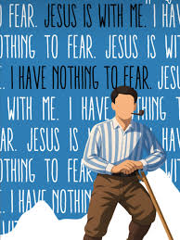
Final Thought...
St Pier Giorgio Frassati
Next weeks theme: Stewardship

